Slide 1


Slide 2
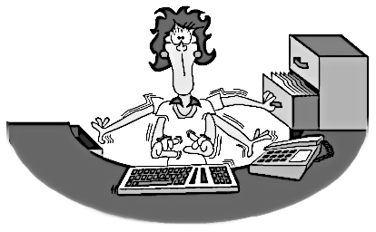


Slide 3




Slide 4
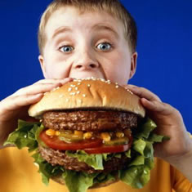
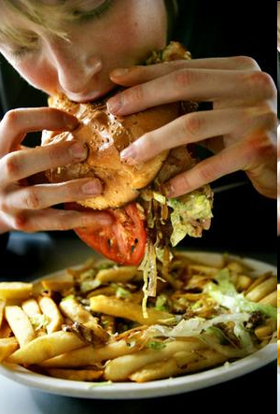

Slide 5
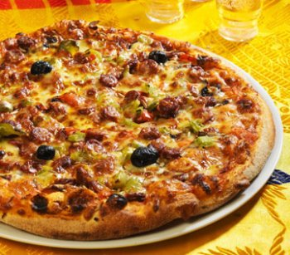
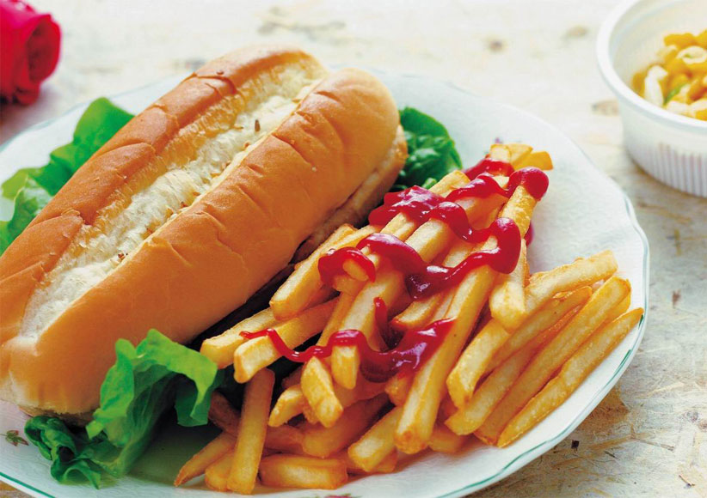
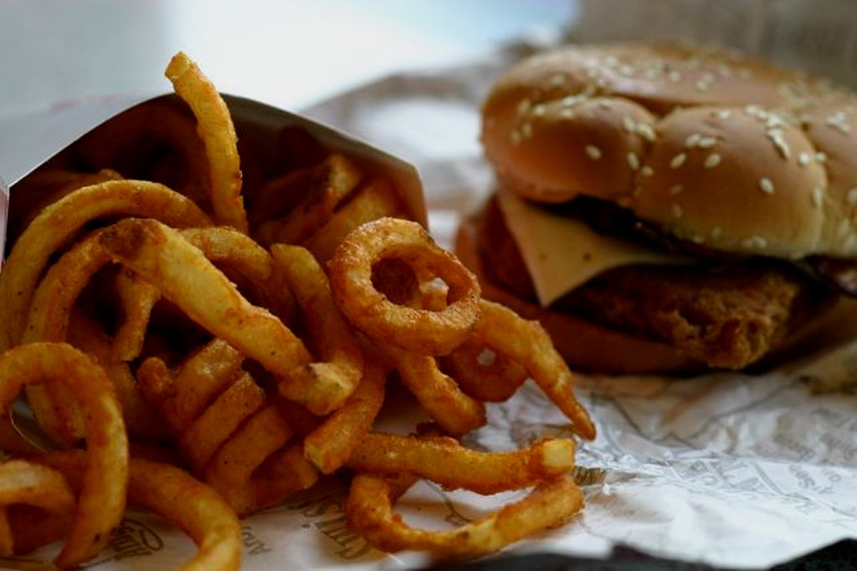


Slide 6
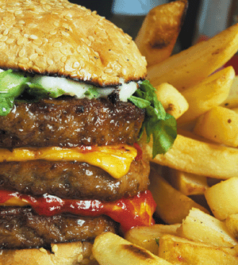
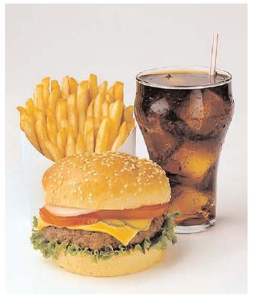

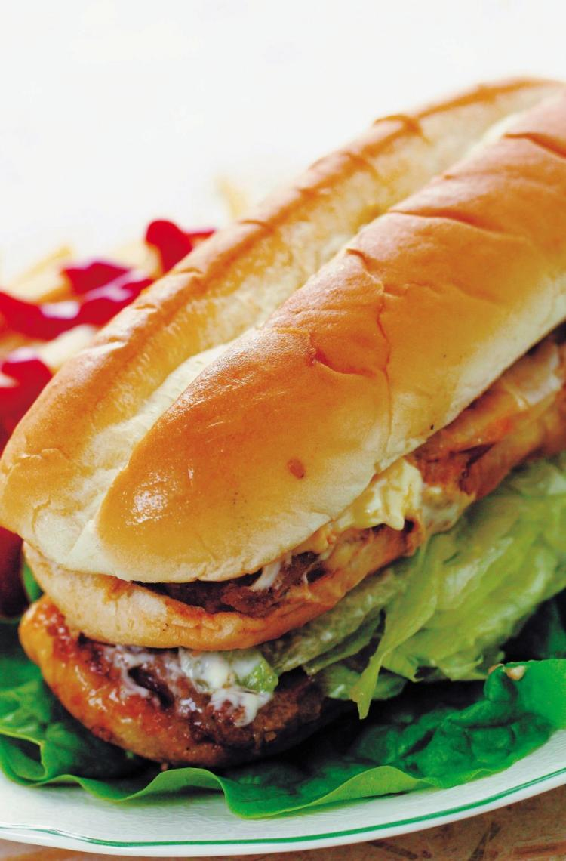
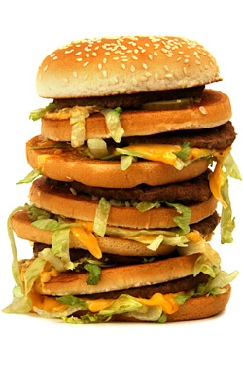

Slide 7
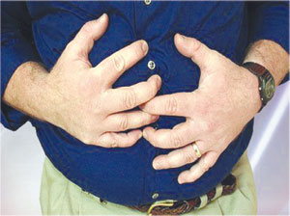

Slide 8
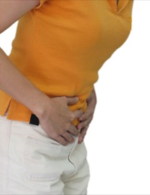



Slide 9
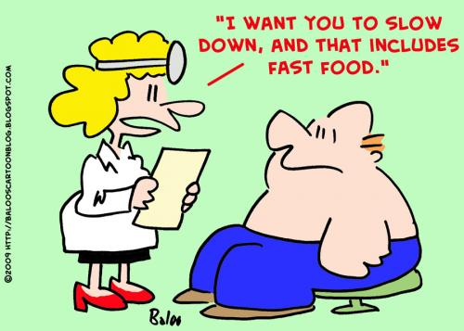

Slide 10

Shock

Slide 11

What is COLON!?

Slide 12
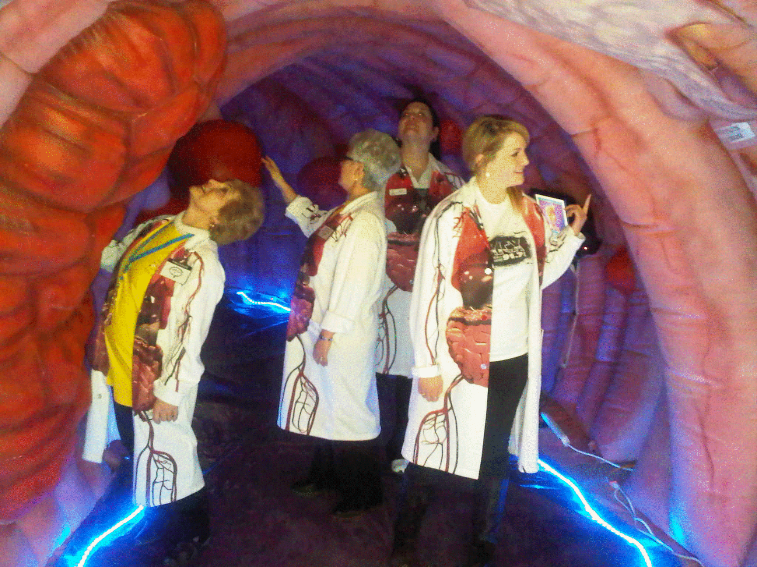

Slide 13
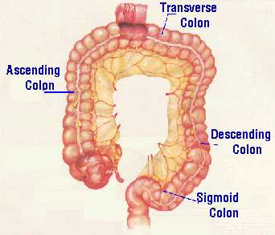
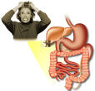

Slide 14




Slide 15

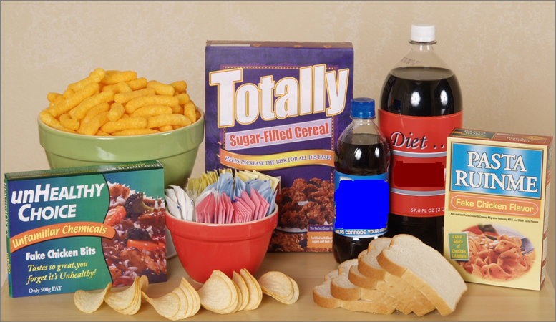
If it’s not food, don’t eat it!
Kelly Hayford, CNC ~ Author: If It’s Not Food, Don’t Eat It!

Slide 16
References
http://www.medterms.com/script/main/art.asp?articlekey=5655
http://special.alwazer.com/show.php?id=518
http://www.biologyonline.org/dictionary/Nervous_colon_syndrome
http://www.medterms.com/script/main/art.asp?articlekey=4541
http://www.wikipedia.org
http://www.youtube.com

Slide 17
THANK YOU…
Presented by:
Suzan Adel

